Slide 1
Module 3 – Data Presentaion

Slide 2
Exploratory Data Analysis (EDA)
Before the main body of statistical analysis, we need to a give the stakeholders and researchers (ourselves) a description of the data with visualizations or simple calculations.
Some ways EDA is used for:
Summarize and visualize main characteristics of the data.
Look for patterns in the data and form hypothesis.
Narrow in on certain problems to study.
Find motivations for studying certain problems.
Uncover new opportunities.
The type of visualization or calculation will depend on the type of data.

Slide 3
Characteristics of Numerical Data
Numerical data have 3 main characteristics: center, variability or dispersion, and the shape.
Central tendency of the distribution is a measure of where "the middle" is.
Dispersion, or spread of the data, is a measure of how far away the data is from the center.
Shape is visually shown in the distribution curve and can be described by the peak, skewness, and degree of symmetry.

Slide 4
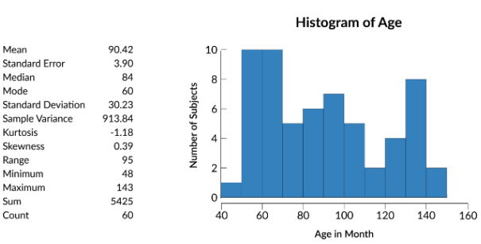
Data Presentation – Numerical Data
e.g. A frequency table and histogram can describe the distribution of a single variable (e.g. Age).
The histogram shows multiple peaks, one at each of 60, 90, and 130 months. The mean is 90. The standard deviation is 30. We expect to see most of the data within one standard deviation of the mean, between 60 and 120.

Slide 5
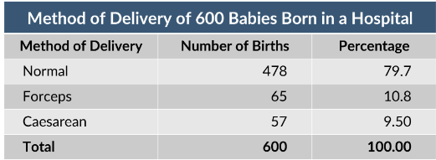
Data Presentation – Categorical Data
Categorical data can be described using graphical or tabular visualizations such as a bar chart, pie chart, or table.
e.g. A table showing the frequencies or percentages of each level of variable or category.

Slide 6
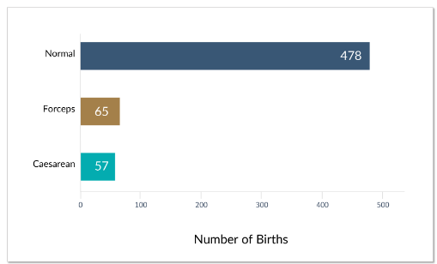
Data Presentation – Categorical Data
A bar chart can show the frequency of categorical variables graphically (called a frequency distribution or frequency chart).

Slide 7
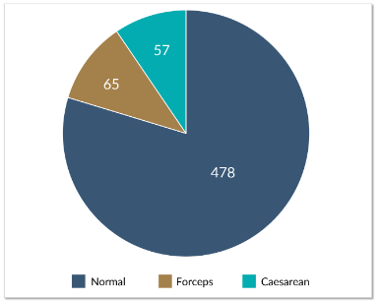
Data Presentation – Categorical Data
A pie chart can show the relative proportions of different categories of a variable in percentages or numbers.

Slide 8
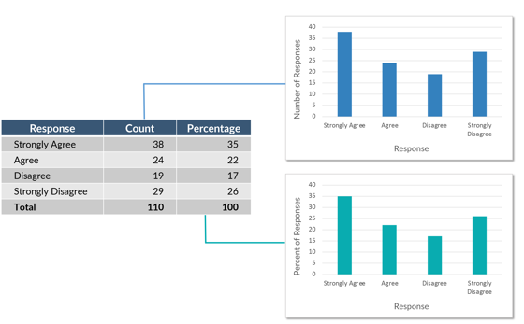
Data Presentation – Categorical Data
When we have ordinal data, we can use either frequency and percentage charts or a data table. A pie chart is less helpful for ordinal data because it doesn't have an inherent order, such as left to right or top to bottom.

Slide 9
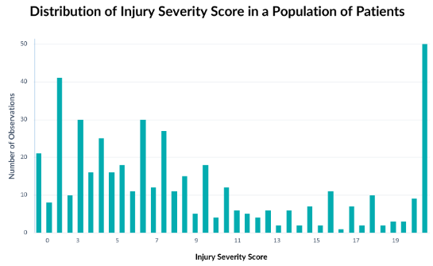
Data Presentation – Numerical Data
Frequency or percentage charts can display numerical data. This chart shows the frequency of Injury Severity Scores for a given population of patients.

Slide 10
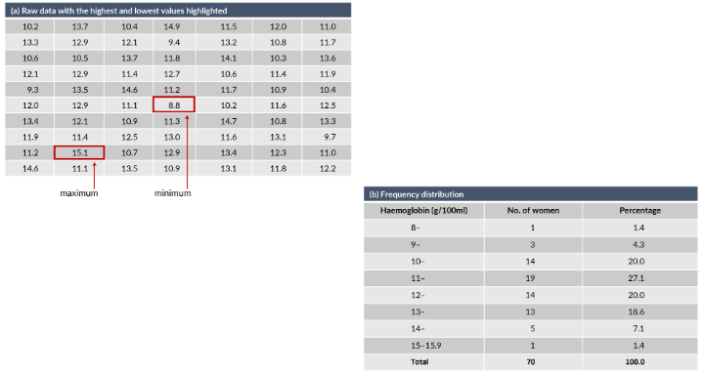
Data Presentation – Numerical Data
It is possible to take continuous data and turn it into categorical data by grouping values together. Then we can calculate frequencies and percentages for each group to be displayed in a table.

Slide 11
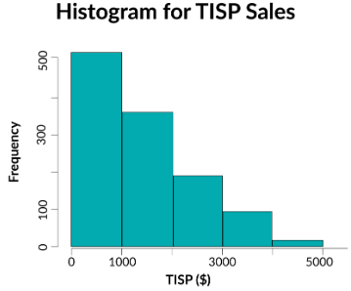
Data Presentation – Distributions
A histogram is a bar chart presentation of the frequency table.
The data is binned and the counts for each bin are displayed graphically. In a histogram, the y-axis is always frequency or the number of data points that fall in the given bin.

Slide 12
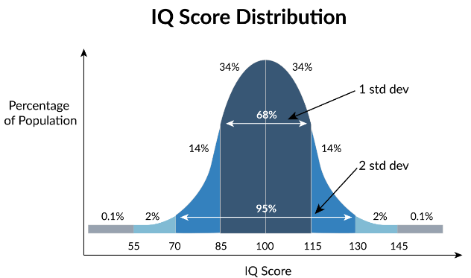
Data Presentation – Distributions
Frequency distribution of numerical data shows the frequency of each value of a variable. It can be considered a ‘smoothed’ histogram.
Measures such as mean, median, mode, standard deviation, kurtosis can be used to describe the distribution.

Slide 13

Data Presentation – Distributions
A boxplot is a graph of the five-number summary.
A central box spans the quartiles (inter-quartile range, IQR).
A line in the box marks the median.
Lines extend from the box out to the smallest (minimum) and largest (maximum) values.

Slide 14
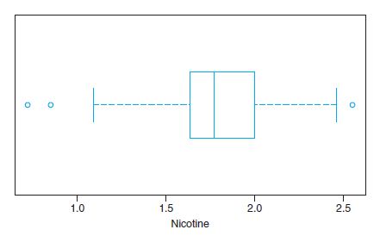
Data Presentation – Distributions
Boxplots can show outliers as dots above and below the whiskers.
A data point may be considered an outlier if the distance from the box is 1.5 times the IQR in either direction (less than first quartile – 1.5 IQR or greater than third quartile + 1.5 IQR).
e.g. Distribution of nicotine content in a sample of cigarettes.

